Slide 1
Evolving your Power BI Architecture using Dataflows and Shared Datasets
Ben Watt
www.datalineo.com

Slide 2

Agenda
History lesson: Microsoft BI Enterprise Architecture
Power BI Architecture. Simple.
Dataflows
Shared Datasets
Power BI Architecture. Evolved.
Link to slides, content

Slide 3



At your Service!
Managing Director at Datalineo
Microsoft MVP Data Platform
Power BI: SQL/Azure/Power Platform
Dublin PUG leader
Event Co-Ordinator:
Data Ceili
Power Platform WT
Ben Watt
@benrebooted

Slide 4
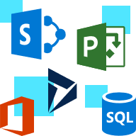






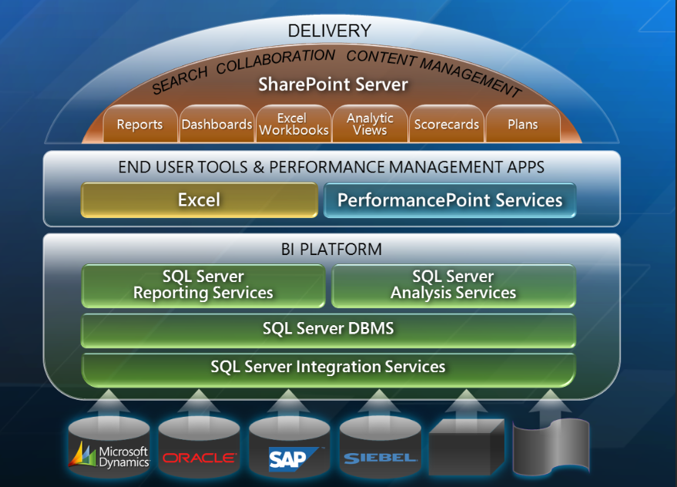
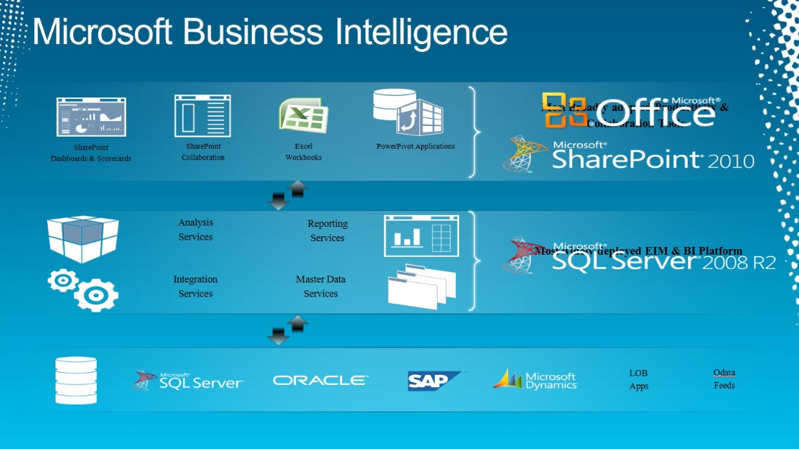
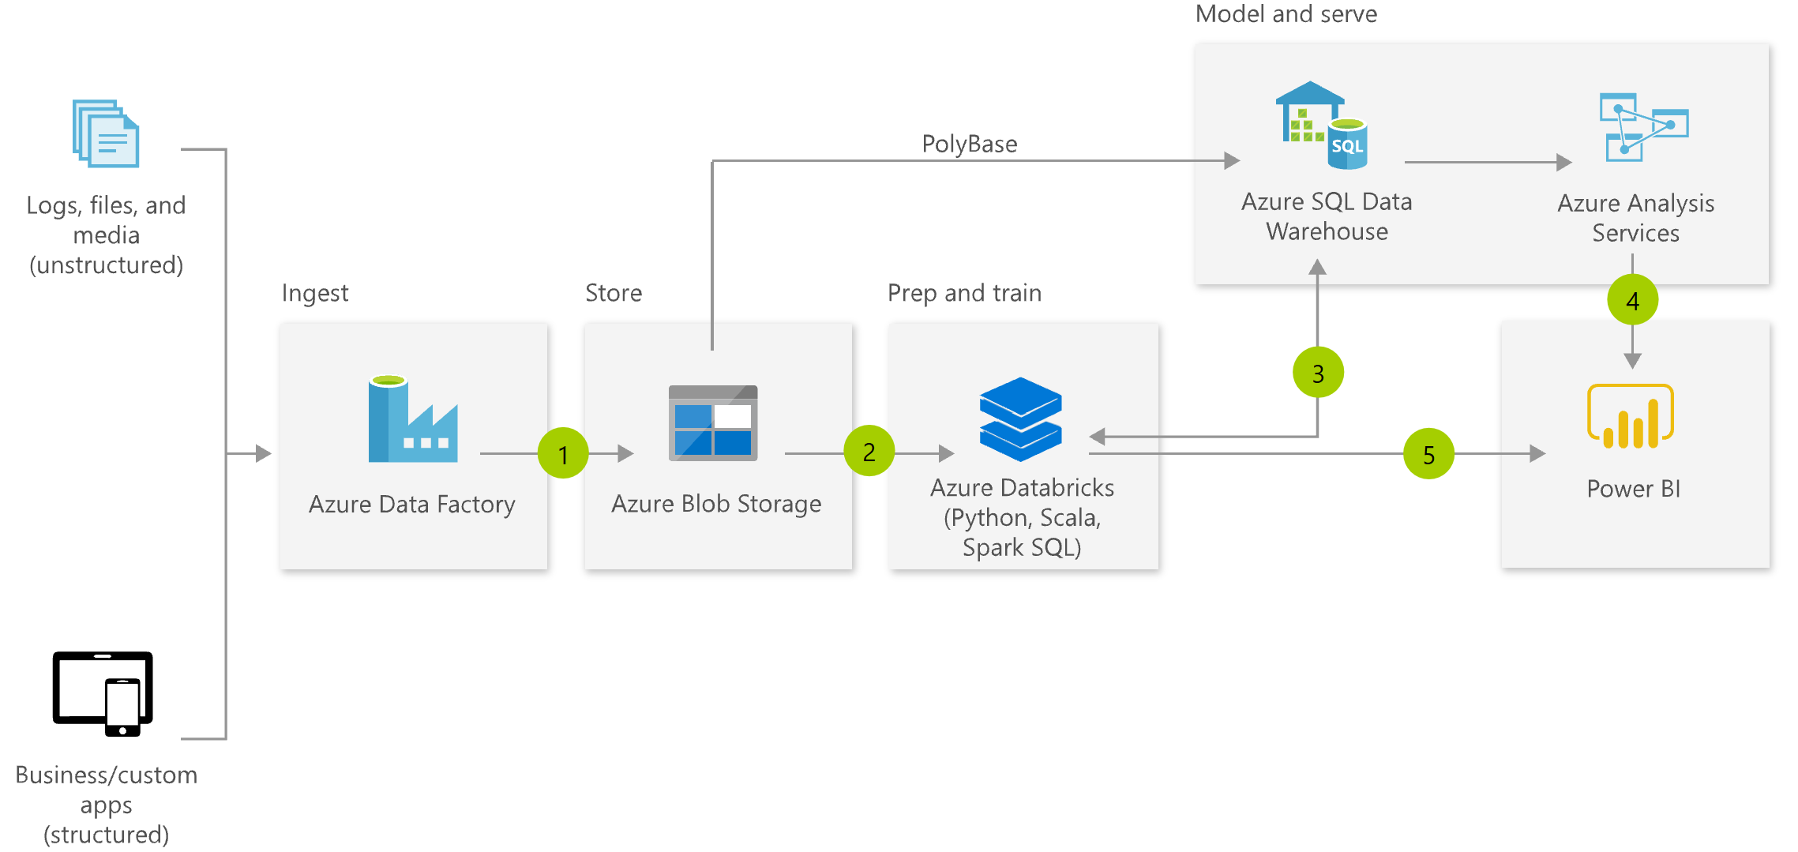
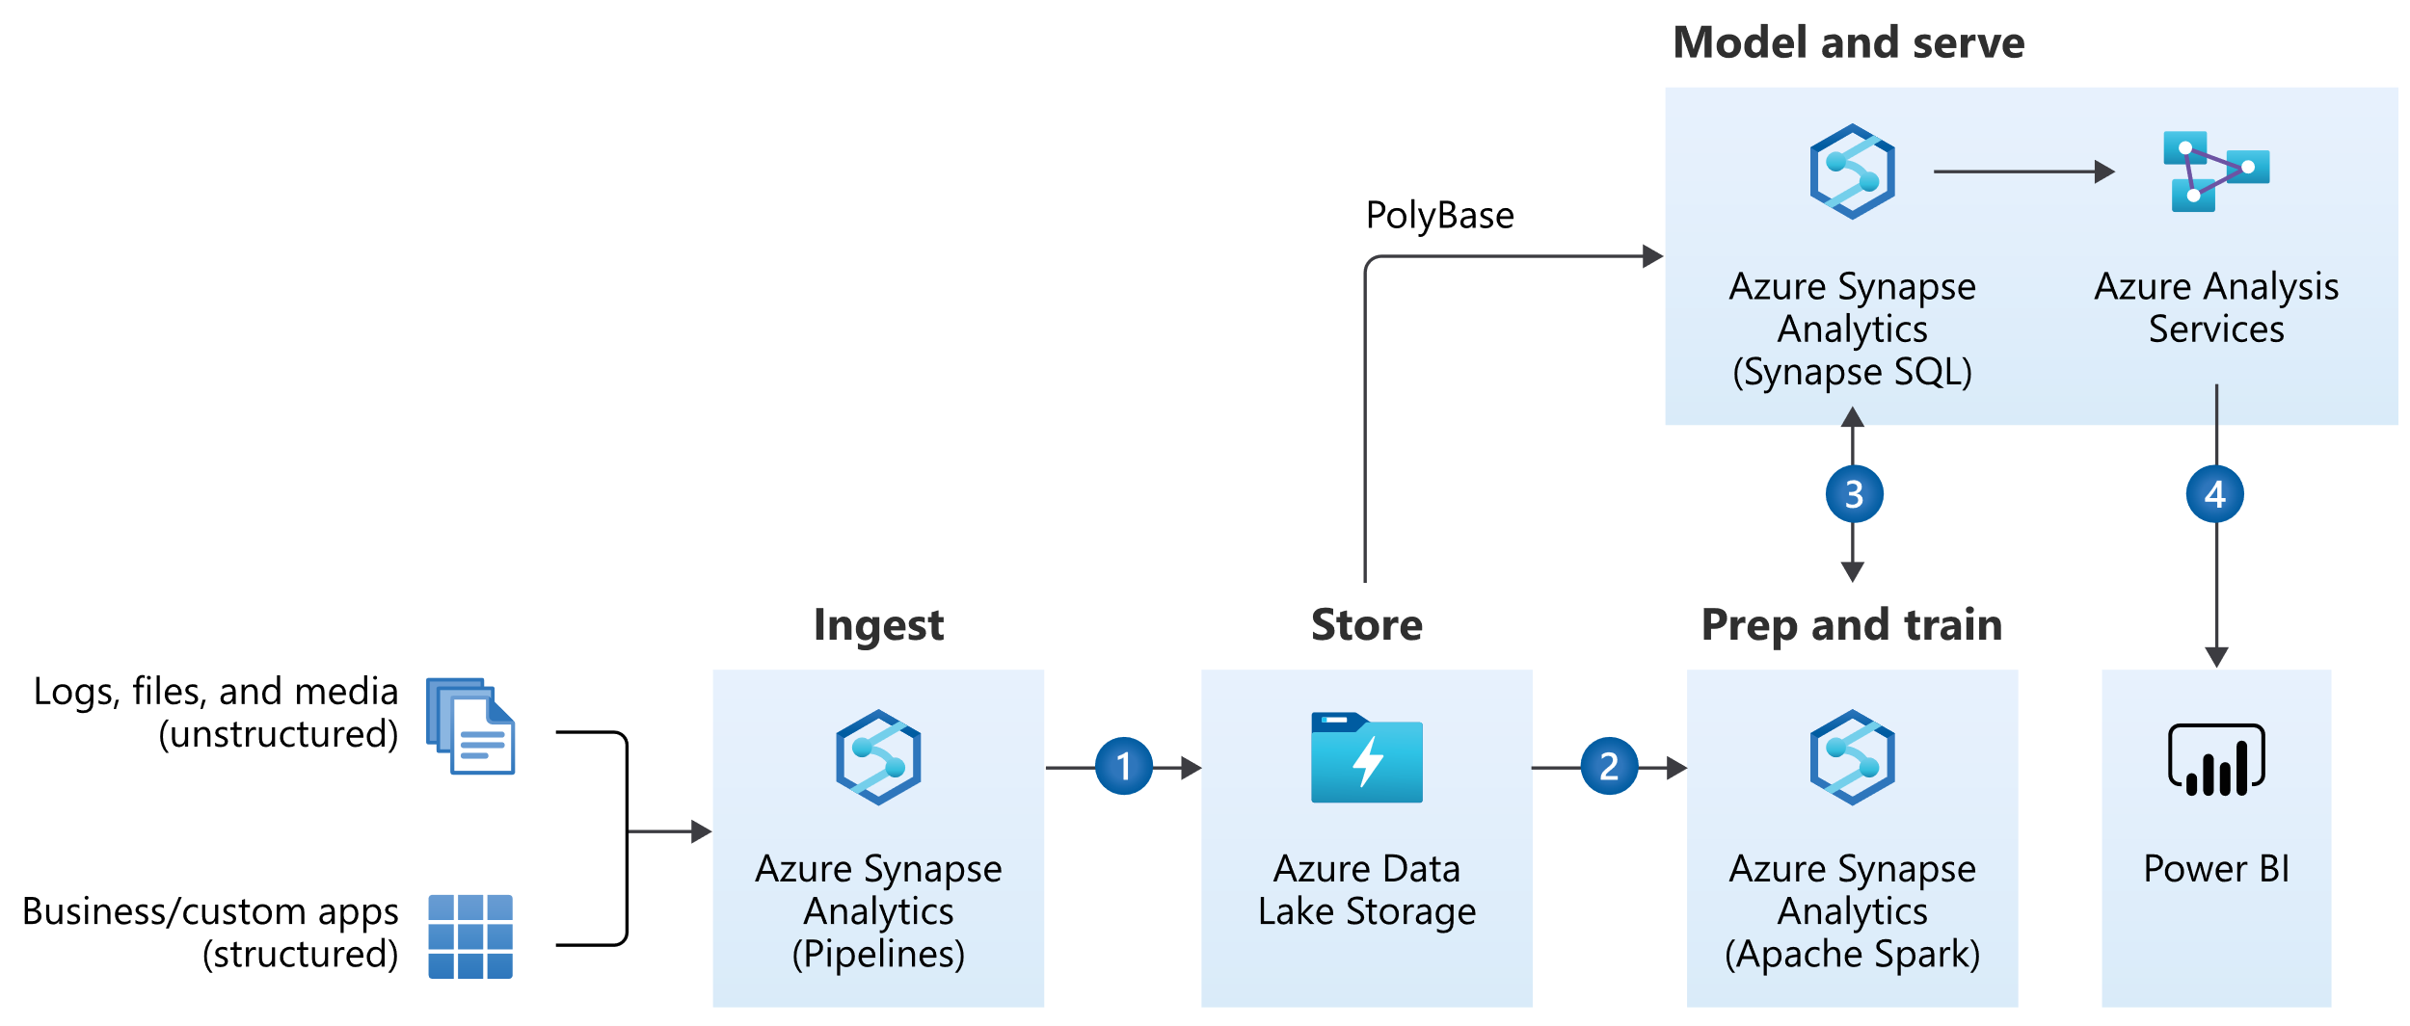
History Lesson: Microsoft Enterprise BI
Get
Store
Model
Data Viz
Typical BI Solution
SQL Server/On-Prem
SSIS
DWH
SSAS
SSRS++
Tools & Technology
Azure/Cloud
ADF
SQL DB
AzureAS
Power BI
Solution Architecture through the ages

Slide 5


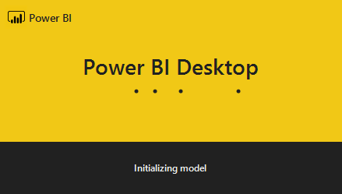

Power BI Solution (simple version)
Store
Semantic
Model
Data Viz
Get
Power BI
Power Query
PBI SSAS
PBI Viz
Power BI Service
Workspaces
One single PBIX file.
Includes:
Get, Model, Data Viz
Publish to a single workspace
Schedule refresh
Schedule
Finance
.PBIX
Sales
Works for..
Small number of report pages
Consistent audience
Minimal development

Slide 6

Let’s scale up!
Shared Datasets and Dataflows.

Slide 7
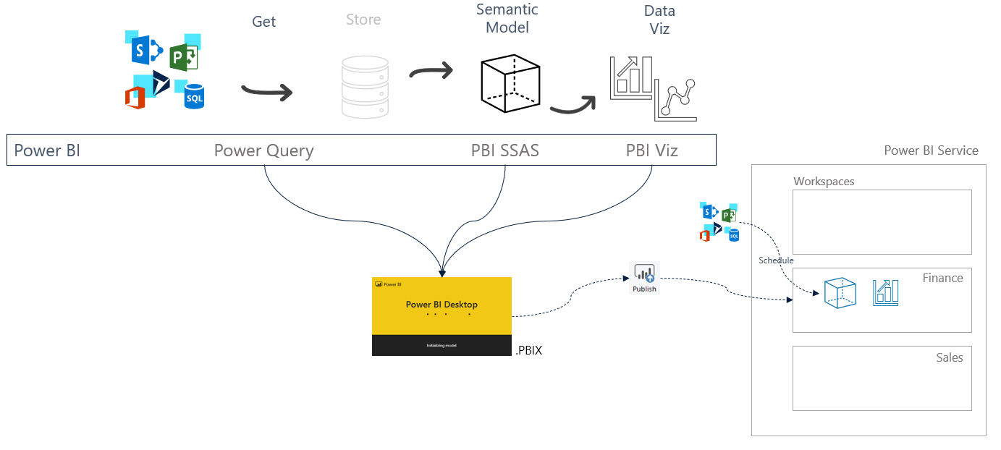
Features to help you scale. Part I - Dataflows
Dataflows
Decouples the data acquisition and scheduling from your .PBIX file
Creates new “entities”/“tables”, available for multiple PBIX datasets
Acts like the ETL and DWH of Enterprise BI
Developed in browser (or copy/paste from Desktop)
Data is stored in Azure Data Lake Gen2 as CDM compliant folders.
10GB (Pro), 100TB (P1), or BYO
Premium features
Enhanced Compute Engine
Incremental refresh
Parallel refresh
Linked/Computed Entities
AI Insights

Slide 8
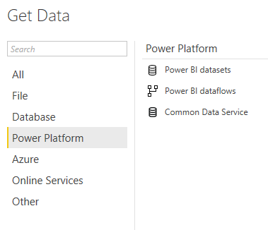



Features to help you scale. Part II – Shared Datasets
Shared Datasets
Decouples the Data Model from the Data Viz
Same .PBIX file, just plays the Data Model role
Use Live Connection .PBIX for reports
Security
Apps
Workspaces
Row Level
Build Access
Simplifies Data Model v Report deployment
Certify and Promote Datasets
Promote or Certify Datasets
Power BI Service
Data Warehouse
Schedule
Finance
Live
connection
Sales

Slide 9





Power BI solution (evolved)
Typical BI Solution
Store
Semantic
Model
Data Viz
Get
SQL Server/On-Prem
SSIS
RDBMS
SSAS
SSRS
Tools & Technology
Azure/Cloud
ADF
SQL DB
AzureAS
Power BI
Shared Data Model
Live
Connection Reports
Dataflows
Your new Evolved Architecture!
Power BI Evolved
Power Query
CDM
PBI SSAS
PBI Viz
Dataflows

Slide 10
Benefits Summary
Dataflows
Shared Datasets
Generates a new Data acquisition, preparation and procurement layer. (or a mini DWH of sorts)
Shared output for re-usable query results
Released pressure on source data
Improved refresh failure issues
Better organisation of multiple reports/pages
Simpler deployment process: Dataset v Reports
Granular security
Flagging of Certified or Promoted Datasets
Data Analysts → Analysis & Insights
BI Developers → Self-service Platform

Slide 11

Slides, etc:
https://github.com/datalineo/sessions
Other links
Enterprise Deployment Whitepaper
https://docs.microsoft.com/en-us/power-bi/guidance/whitepaper-powerbi-enterprise-deployment
Shared Datasets
https://docs.microsoft.com/en-us/power-bi/connect-data/service-datasets-share
Dataflows
https://docs.microsoft.com/en-us/power-bi/transform-model/dataflows/dataflows-introduction-self-service
Hit me up…
EMAIL
WEBSITE
TWITTER
ben@datalineo.com
www.datalineo.com
@benrebooted

